Slide 1
GROUP: 11
DEEP LEARNING FINAL PROJECT
DECODING MOVIE OPINIONS WITH RNNs: ANALYSING SENTIMENT OF IMDB REVIEWS
&
BATTLESHIP BOARD GAME: OPTIMAL STRATEGY FOR A COMPUTER (AI) TO PLAY
Subramanian Arumugam
Rida Fathima
Hari Priya Avarampalayam Manoharan
Agash Sekar
Abinesh G

Slide 2
Motivation & Problem

Slide 3
Problem Statement
To predict the sentiments of Movie Reviews using RNN.

Slide 4
Proposed Solution
We aimed to predict sentiments of IMDB Movie Reviews using –
Bi- Directional LSTM
LSTM (Unidirectional)
CNN with LSTM

Slide 5
Dataset Description

Slide 6
Dataset Description
The dataset has 49,582 rows with two columns – Reviews, Sentiment.
The target variable is Sentiment with – 24,884 Positive Reviews and 24,698 Negative Reviews
Classes
Positive
Negative

Slide 7
Data Preparation

Slide 8

Preprocessing Stages
Removing the duplicates
Label Encoding on target variable
Removed Missing values
Removed Stop Words
Changed all the text to lowercase to get the unique words
Removed URL's and Symbols
Lemmatization on the reviews.

Slide 9
Exploratory Data Analysis

Slide 10
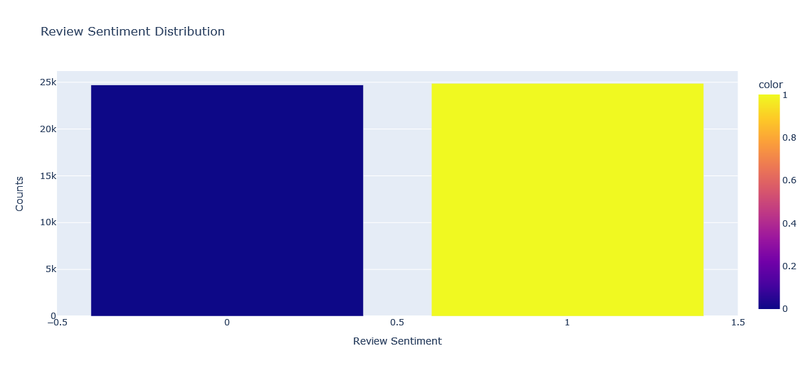
Distribution of Positive and Negative Reviews
Positive Reviews = 49.81 %
Negative Reviews = 50.19 %

Slide 11
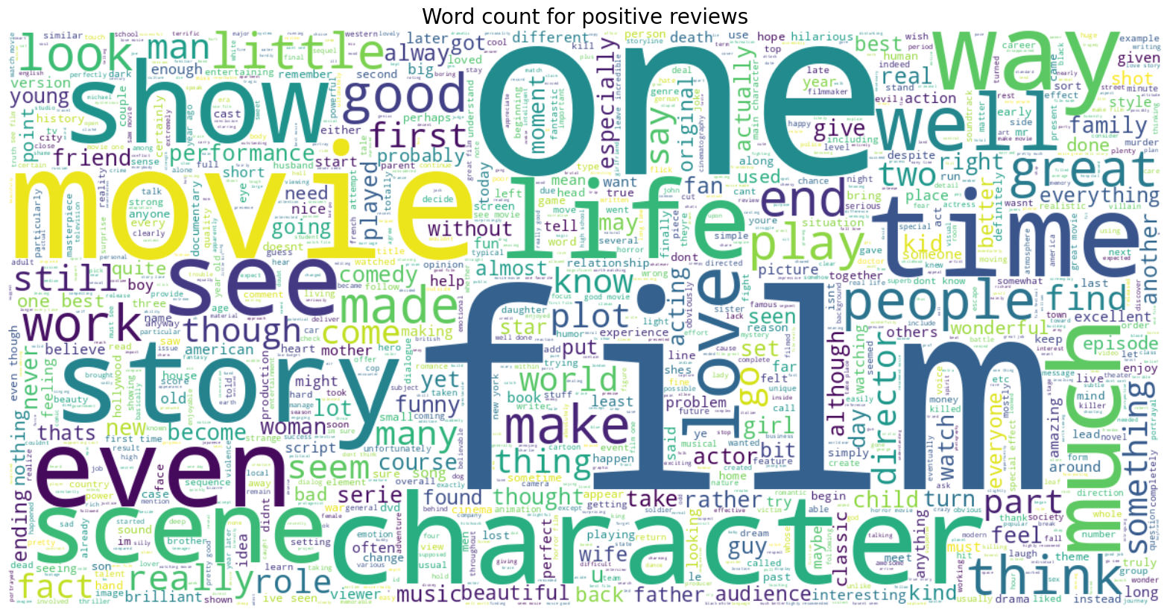
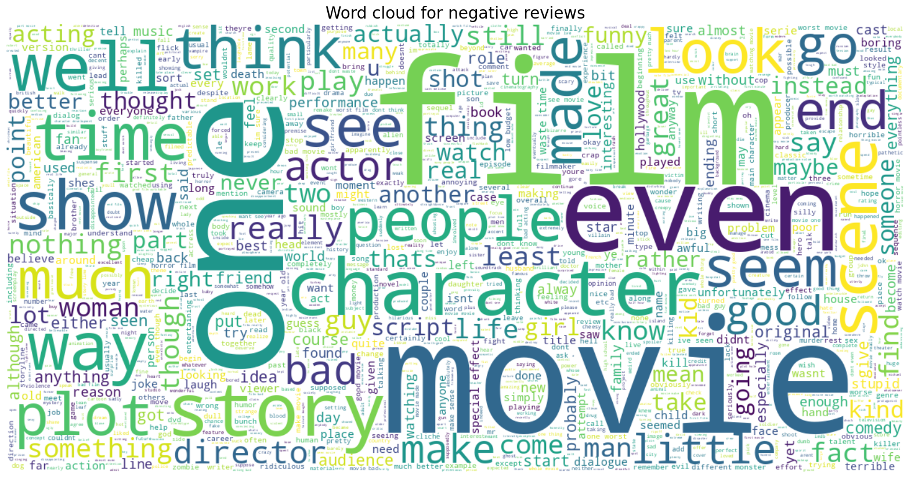
Word Cloud for Positive and Negative Reviews
Word Cloud for Positive Reviews
Word Cloud for Negative Reviews

Slide 12
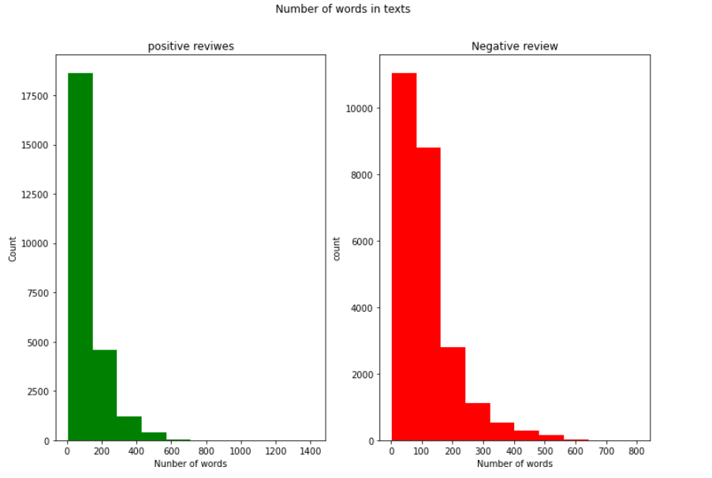
Word Count in Positive and Negative Reviews

Slide 13
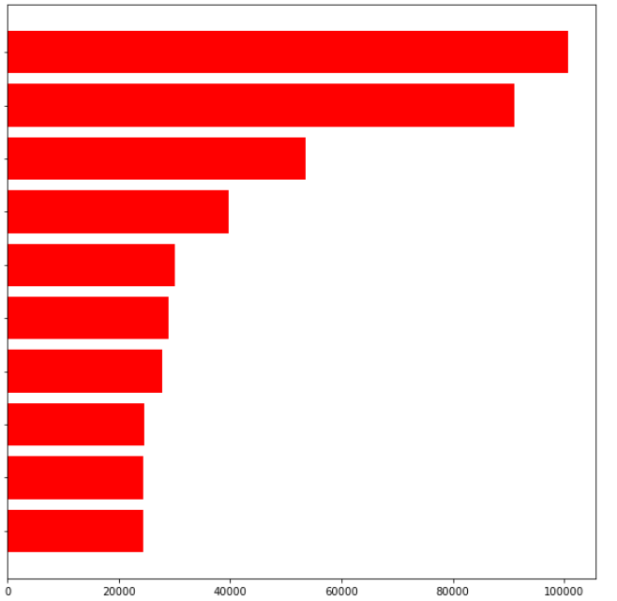
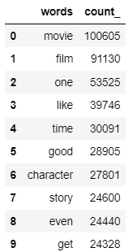
Common Words in Dataset
Movie
Film
One
like
time
good
character
story
even
get

Slide 14
Modeling
Bi-directional LSTM

Slide 15
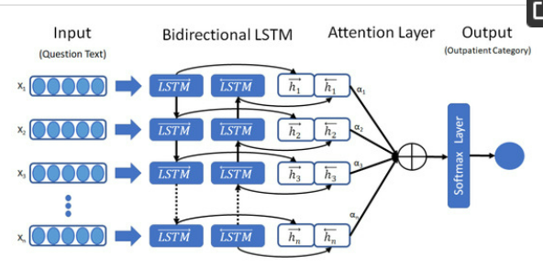
Bidirectional LSTM Model
Tokenization: The process of breaking down a text into individual units, or tokens, such as words or sub-words.
Bidirectional LSTM is a type of recurrent neural network that processes input sequence in both forward and backward directions to capture past and future context.
Grid Search: To decide best parameters
Activation Functions: Relu, Sigmoid
Dropout: To avoid overfitting
Image Ref: Link

Slide 16
Bidirectional LSTM Model
Grid Search to decide parameters
Tokenization
Embedding
Bidirectional LSTM (150)
Dropout (40%)
Dense (Relu, 512)
Model Sentimental Prediction
Call Back & Scheduler
Dense (Sigmoid, 1)
Dropout (50%)

Slide 17
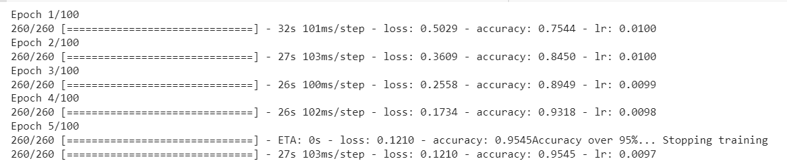
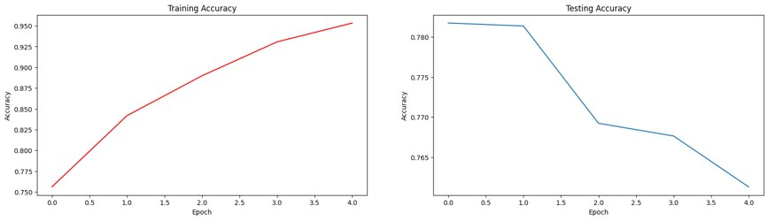
Results
Train Accuracy & Loss
Test Accuracy
Accuracy on Test Data: 76.13%

Slide 18
Modeling
Unidirectional LSTM

Slide 19
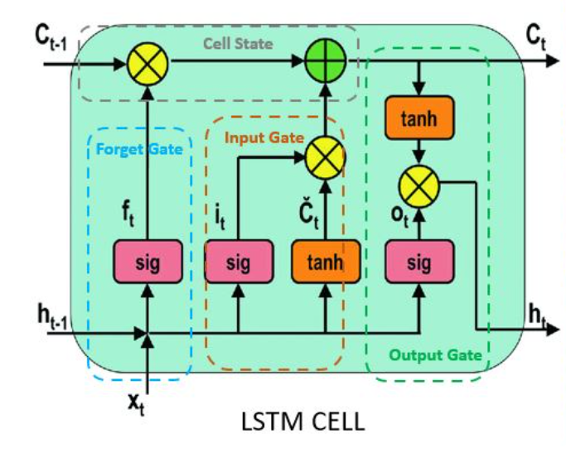
LSTM Model (Unidirectional)
Unidirectional LSTM: It processes sequential data in a single direction, using memory cells and gates.
Embedding is a technique used to represent text data as dense vectors, which can capture the meaning and context of words
Optimizer: RMS Propagation was used to normalize the learning rate of each weight in the model.
Grid Search: To decide best parameters
Activation Functions: tanh, Sigmoid
Image Ref: Link

Slide 20
LSTM (Unidirectional )
Grid Search to decide parameters
Tokenization
Embedding
LSTM (128)
(tanh)
Prediction
Optimizer (RmsProp)
Call Back & Scheduler
Dense (Sigmoid, 1)

Slide 21
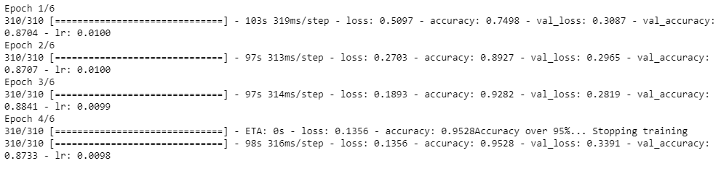
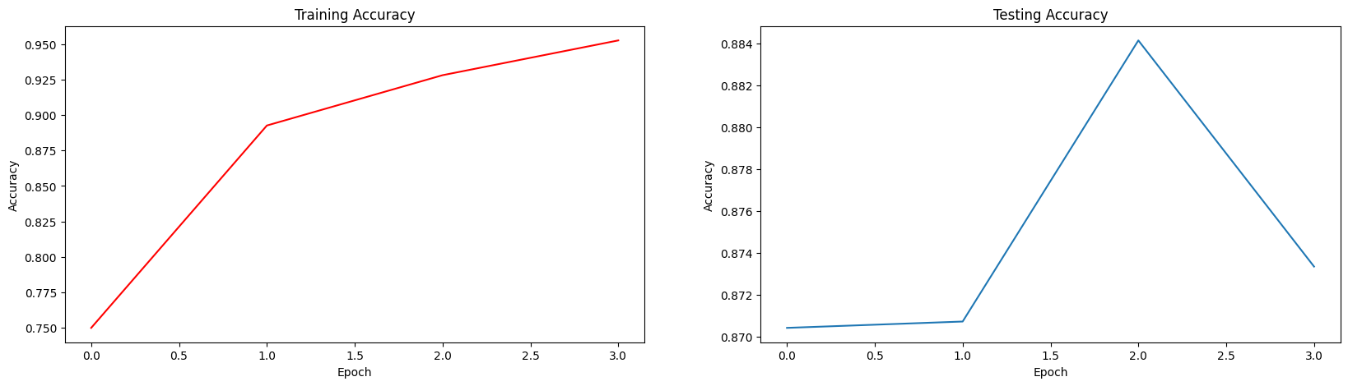
Results
Accuracy on Test Data: 87.33%

Slide 22
Modeling
CNN with LSTM

Slide 23
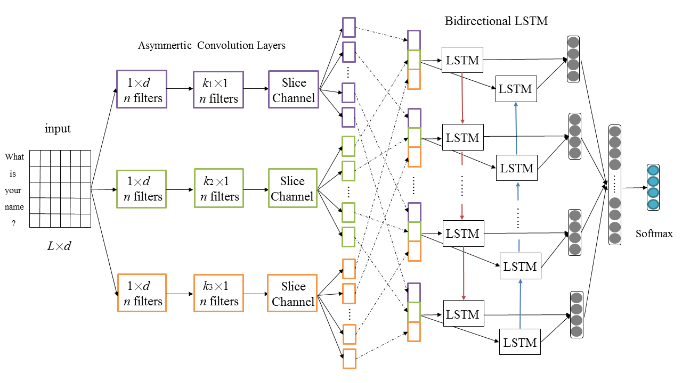
CNN with LSTM Model
Text Vectorization: Performs tokenization, vocabulary building, and index assignment to convert raw text into a sequence of integers that can be used in various NLP tasks.
Text Vectorization v/s Tokenization: Text Vectorization allows for easier integration with other layers in a Keras model.
CNN:
LSTM network can only capture temporal dependencies in sequential data
The addition of a CNN component to LSTM enhances the ability to capture higher-level features in the input data.
Activation Functions: Relu, Sigmoid
Image Ref: Link

Slide 24
CNN with LSTM Model
Text
Vectorization
Embedding
Conv 1D (32,5)
Conv 1D
(16, 5)
MaxPooling1D
Flatten
(16)
Dense
(Relu 16)
Dense
(Relu, 32)
Bidirectional LSTM (128)
Grid Search to decide parameters
Dense
(Sigmoid 1)
Model Sentimental Prediction

Slide 25
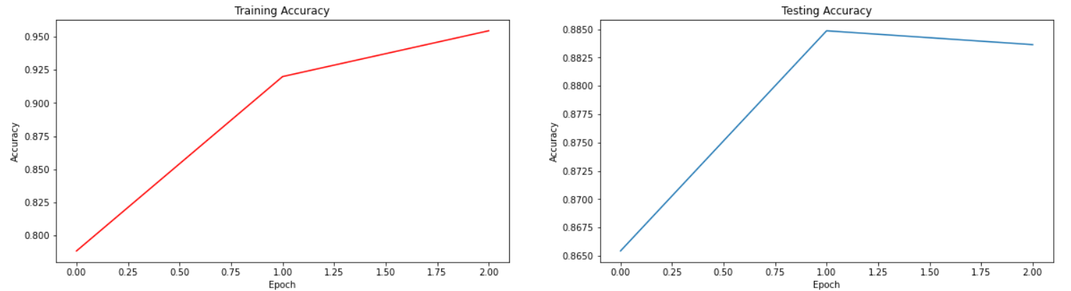
Results
Train Accuracy
Test Accuracy
Accuracy on Test Data: 88.36%

Slide 26
Result

Slide 27
Results
Model | Result
Bi-Directional LSTM | 76.13 %
LSTM (Unidirectional) | 87.33 %
CNN with LSTM | 88.36 %
The CNN with LSTM model worked the best for the IMDB Movie Review Sentiment Prediction data set with the highest Test Accuracy of 88.36 %.

Slide 28
Reinforcement Learning​

Slide 29
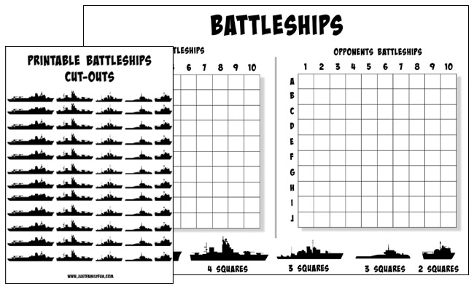
BATTLESHIP
Battleship is a classic board game that has been popular for decades. It is a strategy-based game that requires players to think tactically and make strategic moves to win.
The game is played on a grid, which is typically 10x10, and each player places their ships on their grid in a way that is hidden from their opponent.
The goal of the game is to sink all the opponent's ships before they sink yours.

Slide 30
DETAILED DESCRIPTION
Actions:
Place Ships: Each player places a set of ships of varying sizes on their grid.
Guess: Each player takes turns guessing the location of the other player's ships on their grid.
Hit: If a player correctly guesses the location of an opposing ship, it is considered a hit.
Miss: If a player incorrectly guesses the location of an opposing ship, it is considered a miss.
Sunk: If all the spaces occupied by a ship are hit, the ship is sunk.
States:
Ship Placement: The placement of each player's ships on their grid.
Guesses: The previous guesses made by each player.
Hits: The previous hits made by each player.
Misses: The previous misses made by each player.
Sunks: The previous sunks made by each player.
Rewards/Penalties:
Reward: The reward for the AI player is for successfully hitting and sinking the opposing player's ships.
Penalty: The penalty for the AI player is for making an incorrect guess, which results in a miss and wastes a turn.
Other Game Mechanics:
Randomness: The game involves an element of randomness as players do not know the location of the opposing player's ships.
Strategy: The game involves strategic thinking and decision-making, such as where to place ships and where to guess.

Slide 31

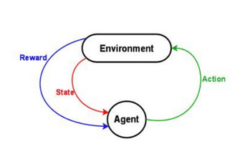
HYPOTHESIS , LAYERS ACTIVATION FUNCTION
Hypothesis for Action Rule
Hypothesis for Action Rule
Hypothesis for State Distribution
Neural network implementation using convolutional layers, dense layers, and an output layer
Input layer takes the current state of the game board as a 2D array
Convolutional layers extract features such as ship patterns and untargeted ships
Flatten layer converts output of convolutional layers to a 1D vector
Dense layers learn a mapping between extracted features and optimal policy for selecting moves
Output layer produces a probability distribution over possible actions using activation functions such as softmax to ensure probabilities sum to 1

Slide 32
ANALYSIS PROCEDURE
Define the environment
Design the agent
Test the agent
Define the rewards
Train the agent

Slide 33
Thank You

